Slide 1
How to Submit Histology Samples Through The Online System-Tutorial Josh Jefferson
You must register first as user or P.I.
Then you must first access the ilab website (https://my.ilabsolutions.com/service_center/show_external/5601/histology_core#iLab%20Solutions) .
2. Click on Request Services

Slide 2
Initiate Request
Click on initiate request
Then the service request page will come up and you will select your designated laboratory Principal Investigator of funding source.
Then click proceed.

Slide 3
Submission Form
Complete the submission form as usual and click save completed form.
Then click on add service.

Slide 4
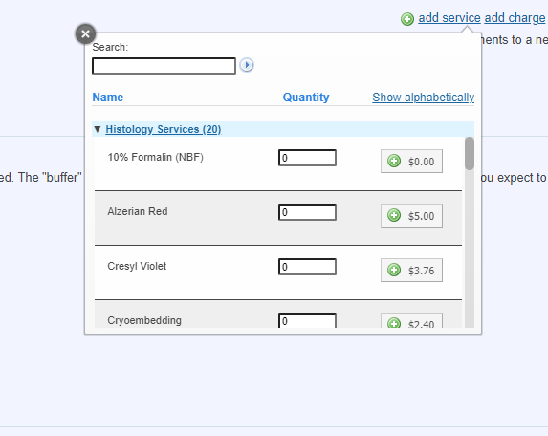
Add services to start creating billable charges
Click “add services” tab and a snap and a tab will pop down.
Scroll down and select how many samples you will have to be processed, stain and cut.
Once you put a number in the quantity box, then you will click the green plus symbol and it will add it to your form.
(It will be shown in the next slide.)

Slide 5
Once you begin adding services, they will show up on your online submission form. The example provided at the bottom is exactly what it will look like. For all paraffin embedded sample stains, you must select the processing and embedding as it is a prerequisite.
Example one. Technician A submitted 5 samples to the core for histology processing. According to her form she wants the samples to be processed and embedded plus one h&e per slide and 10 unstained slides for a total of 11 slides cut per sample.
If everything looks correct scroll down the page to the cost section and fill out the billing information.

Slide 6
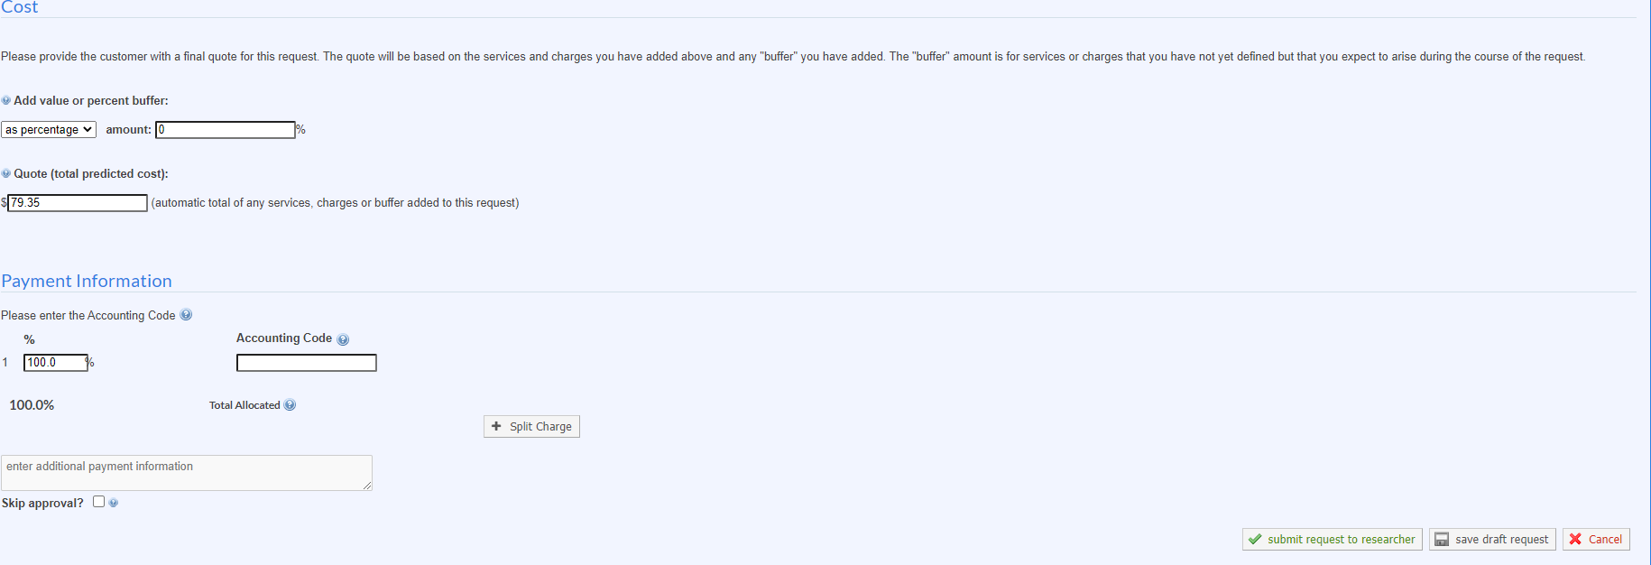
1. You will be shown the projected cost of your project. You can scroll back up and adjust your quantity submission if needed and it will recalculate the price. Once you have made the needed corrections and everything looks correct, then click “ submit request to researcher” at the bottom of the page .
If you are still having problems please call me at 601-329-3846.

